Slide 1

ABC Call Volume Trend Analysis
Optimizing Customer Experience through Data Analytics
Project by :- Raj Rathod |Data Analyst

Slide 2

Introduction
Customer Experience (CX) is a critical differentiator in today's competitive landscape
ABC Insurance Company understands the importance of providing exceptional customer support
This project focuses on analyzing inbound call volume trends to enhance CX strategy

Slide 3

About ABC Insurance Company
Leading player in the insurance sector
Committed to delivering exceptional customer experience (CX)
Recognizes the importance of seamless customer support

Slide 4

Approach
Leveraged a comprehensive dataset spanning 23 days
Performed analytical tasks:
Calculated average call duration per time bucket
Visualized total call volumes using charts/graphs
Proposed manpower allocation plans
Utilized domain knowledge and statistical techniques

Slide 5


Tech Stack Used
Microsoft Excel 2021 (Data analysis, calculations, visualizations)
Microsoft PowerPoint (Presentation)
Purpose: Powerful data analysis and spreadsheet software

Slide 6

Project Objectives
Analyze average call duration for each time bucket
Visualize total call volumes across time buckets
Propose manpower plan to reduce abandon rate (9 AM - 9 PM)
Develop night-time manpower plan (9 PM - 9 AM)

Slide 7
Assumptions
Agent works 6 days a week
Average 4 unplanned leaves per agent per month
9-hour shift with 1.5 hours for lunch/snacks
Agents spend 60% of working hours on calls
30 days in a month
Working Days | 6
Working Hours | 9
Break | 1.5
Actual Working Hours | 7.5
Occupancy | 60%
Total Working Hours | 4.5
Total Working Seconds | 16200
Average Call Time Per Agent | 199
Call Capacity of an Agent/Day | 81
Call Capacity of an Agent/Hour | 18

Slide 8
Average Call Duration Analysis
Calculated average duration of incoming calls for each time bucket is 199 seconds
Gain insights into customer engagement and agent efficiency
Identified peak call volume periods and patterns
Observed variations in average call duration across time buckets
Further analysis reveals that the average call duration for incoming calls received by agents is highest between 10 AM to 11 AM and 7 PM to 8 PM, while it is found to be the lowest between 12 noon to 1 PM.
Gained understanding of customer engagement and operational efficiency

Slide 9

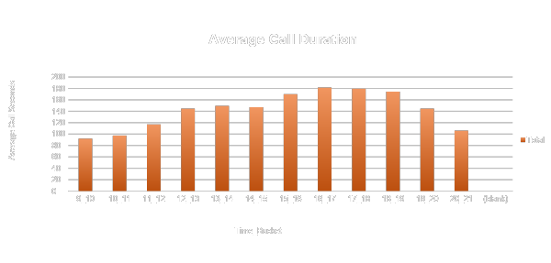

Slide 10

Call Volume Analysis
Visualize total number of calls received across time buckets
Identify call volume patterns and peak demand periods
Peak Call Duration: 10 AM - 11 AM and 7 PM - 8 PM
Lowest Call Duration: 12 noon - 1 PM

Slide 11

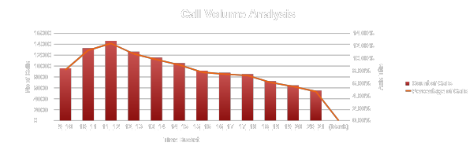

Slide 12
Manpower Planning (9 AM - 9 PM)
Current abandon rate: 30%
Target: Reduce abandon rate to 10%
Propose manpower allocation plan for each time bucket
Ensure at least 90 out of 100 calls are answered promptly

Slide 13
Time Bucket | Answered Calls/Day | Agents Needed | Number of Calls to be answered per day | Agents required to achieve the Target
9_10 | 193 | 11 | 375 | 21
10_11 | 277 | 15 | 520 | 29
11_12 | 372 | 21 | 571 | 32
12_13 | 410 | 23 | 489 | 27
13_14 | 384 | 21 | 448 | 25
14_15 | 347 | 19 | 409 | 23
15_16 | 337 | 19 | 351 | 20
16_17 | 341 | 19 | 336 | 19
17_18 | 330 | 18 | 328 | 18
18_19 | 270 | 15 | 279 | 16
19_20 | 199 | 11 | 251 | 14
20_21 | 125 | 7 | 215 | 12
Time Bucket | Abandon Calls/23 Days | Answered/23 Days | Grand Total/23 Days | Abandon Calls/Day | Answered Calls/Day | Grand Total/Day | Abandon Calls Percentage | No of Calls Required to be answered to make Abandon % upto10
9_10 | 5149 | 4428 | 9577 | 224 | 193 | 416 | 54% | 375
10_11 | 6911 | 6368 | 13279 | 300 | 277 | 577 | 52% | 520
11_12 | 6028 | 8560 | 14588 | 262 | 372 | 634 | 41% | 571
12_13 | 3073 | 9432 | 12505 | 134 | 410 | 544 | 25% | 489
13_14 | 2617 | 8829 | 11446 | 114 | 384 | 498 | 23% | 448
14_15 | 2475 | 7974 | 10449 | 108 | 347 | 454 | 24% | 409
15_16 | 1214 | 7760 | 8974 | 53 | 337 | 390 | 14% | 351
16_17 | 747 | 7852 | 8599 | 32 | 341 | 374 | 9% | 336
17_18 | 783 | 7601 | 8384 | 34 | 330 | 365 | 9% | 328
18_19 | 933 | 6200 | 7133 | 41 | 270 | 310 | 13% | 279
19_20 | 1848 | 4578 | 6426 | 80 | 199 | 279 | 29% | 251
20_21 | 2625 | 2870 | 5495 | 114 | 125 | 239 | 48% | 215
Grand Total | 34403 | 82452 | 116855 | 1496 | 3585 | 5081 | 29% | 4573

Slide 14
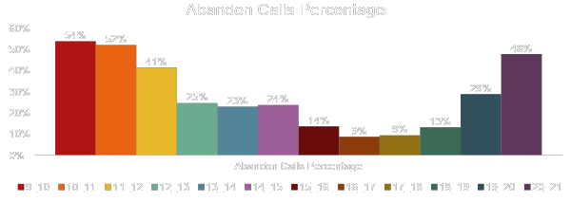
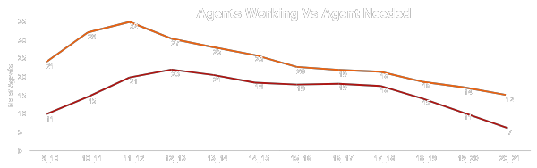

Slide 15
Night Shift Manpower Planning (9 PM - 9 AM)
Accommodate additional 30 calls for every 100 calls received during operational hours
Develop strategic manpower plan for each time bucket
Maintain maximum abandon rate at 10%

Slide 16
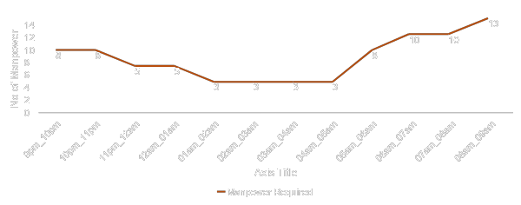
Time Bucket | Distribution of 30 Calls | Percentage | Calls/Night | Manpower Required
9pm_10pm | 3 | 10% | 137 | 8
10pm_11pm | 3 | 10% | 137 | 8
11pm_12am | 2 | 7% | 91 | 5
12am_01am | 2 | 7% | 91 | 5
01am_02am | 1 | 3% | 46 | 3
02am_03am | 1 | 3% | 46 | 3
03am_04am | 1 | 3% | 46 | 3
04am_05am | 1 | 3% | 46 | 3
05am_06am | 3 | 10% | 137 | 8
06am_07am | 4 | 13% | 183 | 10
07am_08am | 4 | 13% | 183 | 10
08am_09am | 5 | 17% | 229 | 13
Grand Total | 30 | 100% | 1372 | 76

Slide 17
Manpower Planning 9AM-9AM
Propose a comprehensive manpower plan for the entire day
Accommodate additional 30 calls for every 100 calls received during operational hours
Develop strategic manpower allocation for each time bucket (24 hours)
Maintain maximum abandon rate at 10%
76 No of Manpower required to meet the Target Rate.
Time Bucket | No of Manpower Required
9am_10am | 21
10am_11am | 29
11am_12am | 32
12pm_01pm | 27
01pm_02pm | 25
02pm_03pm | 23
03pm_04pm | 20
04pm_05pm | 19
05pm_06pm | 18
06pm_07pm | 16
07pm_08pm | 14
08pm_09pm | 12
9pm_10pm | 8
10pm_11pm | 8
11pm_12am | 5
12am_01am | 5
01am_02am | 3
02am_03am | 3
03am_04am | 3
04am_05am | 3
05am_06am | 8
06am_07am | 10
07am_08am | 10
08am_09am | 13

Slide 18

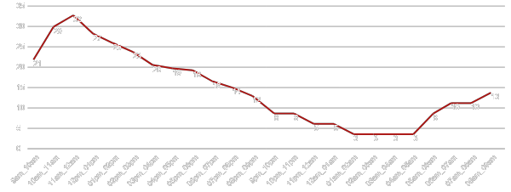
No of Manpower Required

Slide 19

Expected Outcomes
Gain valuable insights into call volume trends and customer engagement
Optimize resource allocation and reduce abandon rates
Enhance customer satisfaction and loyalty
This Photo by Unknown Author is licensed under CC BY-SA-NC

Slide 20

Insights
Identified peak call volume periods and patterns
Observed variations in average call duration across time buckets
Recognized the need for strategic manpower allocation
Gained understanding of customer engagement and operational efficiency

Slide 21
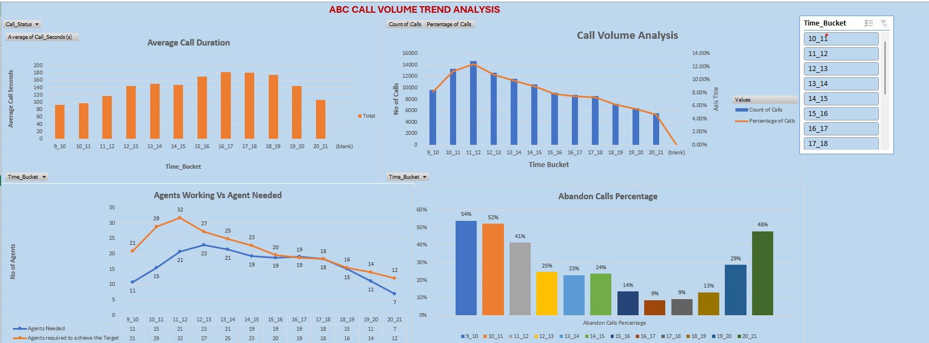
DASHBOARD

Slide 22
Result
Gained insights into the critical role of data analysts in optimizing customer experience (CX) strategies for customer service departments.
Understood the importance of effective customer handling techniques and tools like Interactive Voice Response (IVR) systems with AI capabilities for prompt query resolution.
Appreciated the value of pre-processed data with time buckets and call duration in seconds, streamlining analysis efforts.
Explored the field of behavioral analytics, studying customer behavior patterns to identify trends, preferences, and areas for CX improvement.
Acquired valuable knowledge on the dynamics of customer service operations and the pivotal part analysts play in driving customer satisfaction through data-driven insights.

Slide 23
Thank you!
Linkedin
Excel Sheet Link
Video Presentation Link

